Slide 1
CS3391 Object Oriented Programming
Dr.D.Sivaganesan, Professor,
PSGiTech / CSE

Slide 2
DATATYPES IN JAVA
Data types specify the different sizes and values that can be stored in the variable. There are two types of data types in Java:
Primitive data types: The primitive data types include Integer, Character, Boolean, and Floating Point.
Non-primitive data types: The non-primitive data types include Classes, Interfaces, and Arrays.

Slide 3
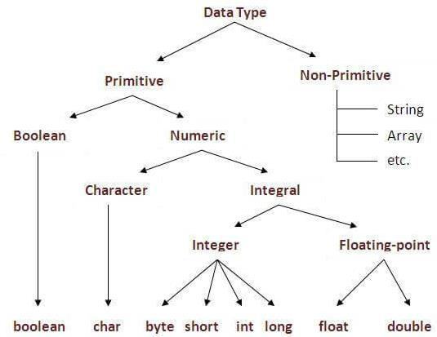
DATATYPES IN JAVA

Slide 4
Integer Data Types
4 types based on integral values: byte, short, int, long
All numeric types are signed. There are NO unsigned types in Java.
Type
Size
Range
byte
short
int
long
8 bits
16 bits
32 bits
64 bits
-128 through +127
-32768 through +32767
-2147483648 through +2147483647
-9223372036854775808 through
+9223372036854775807

Slide 5
Floating point Data Types
2 types based on floating point values: float and double
Storage conforms to IEEE 754 standard
Floating point numbers are not accurate. They are an approximation
floats store 7 significant digits. doubles store 15.
Type
Size
Range
38
38
float
double
32 bits
64 bits
-3.4 * 10 through +3.4 * 10
-1.7 * 10 through +1.7 * 10
308
308

Slide 6
Character data type
The char type defines a single character
In many other programming languages, character types are 8-bits (they store ASCII values). In Java, character types are 16-bits.
Java characters store characters in unicode format.
Unicode is an international character set which defines characters and symbols from several different world languages.
Unicode includes ASCII at its low range (0-255)
Characters can be converted to integers to perform mathematical functions on them.

Slide 7
Boolean data type
The boolean type defines a truth value: true or false.
booleans are often used in control structures to represent a condition or state.
Java characters store characters in unicode format.
Unicode is an international character set which defines characters and symbols from several different world languages.
Unicode includes ASCII at its low range (0-255)
booleans CANNOT be converted to an integer type.

Slide 8
Special Characters
Java defines several "special" characters. All are preceded by a backslash (\) character:
\n
\r
\t
\\
\'
\"
\ddd
\uxxxx
\b
Newline (linefeed character)
Return (carriage return character)
Horizontal Tab
Back slash
Single Quote
Double Quote
Octal represented by octal number
Unicode character (hex)
backspace

Slide 9
Examples for Data Types
Numbers – int (whole no.s), (no.s with decimal point) eg. int i = 23; double d = 33.23
Character – char eg. char c = ‘a’;
String – String eg. String s = “Hi”;
Boolean – boolean eg. boolean b = false;

Slide 10
Identifier and Variables
Identifier refers to name given to entities such as variables, class,objects,methods,arrays,etc.
Identifiers must be unique.
A variable is a container which holds the value and that can be changed during the execution of the program. A variable is assigned with a datatype.
Variable is a name of memory location.
All the variables must be declared before they can be used.
There are three types of variables in java:
local variable,
instance variable and
static variable
Syntax: data type var name = value;

Slide 11
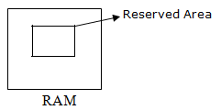

VARIABLES TYPES
20
Local Variable
A variable defined within a block or method or constructor is called local variable.
Instance Variable
Instance variables are non-static variables and are declared in a class outside any method, constructor or block.
Static variable
Static variables are also known as Class variables.These variables are declared similarly as instance variables, the difference is that static variables are declared using the static keyword within a class outside any method constructor or block.
Unlike instance variables, we can only have one copy of a static variable per class irrespective of how many objects we create.

Slide 12
Creating Class
DEFINING CLASSES IN JAVA
A class is a template for an object, and an object is an instance of a class. A class is declared by use of the class keyword
Syntax:
class classname
{
type instance-variable1;
type instance-variable2;
// ...
type instance-variableN;
type methodname1(parameter-list)
{
body of method
}
...
type methodnameN(parameter-list)
{
body of method
}
}
Members of the class

Slide 13
A Simple Class
class Box
{
int width = 10; // instance variable
int height = 12;
void display() //method
{
System.out.println(“ Box Size”+ width+ height)
}
}

Slide 14
Declaring Objects
First, declare a variable of the class type.
Second, you must acquire an actual, physical copy of the object and assign it to that variable. This is done using the new operator. The new operator dynamically allocates (that is, allocates at run time) memory for an object and returns a reference to it. This reference is then stored in the variable. Thus, in Java, all class objects must be dynamically allocated.
Syntax:
classname obj name = new classname ();
Ex:
1. Box mybox = new Box(); (or)
2. Box mybox; // declare reference to object
mybox = new Box(); // allocate a Box object

Slide 15
Accessing object vars and methods
Syntax for accessing class members by object
Accessing data member
objectname.datamemeber
Accessing member method
objectname.methodsname()

Slide 16
Java Progarm with class and object
class Box
{
int width = 10; // instance variable
int height = 12;
void display() //method
{
System.out.println(“ Box Size”+ width+ height)
}
}
class ex
{
public static void main(String args[])
{
Box mybox = new Box(); // creation of object
mybox.display() // calling method
System.out.println(“Hello Java World");
}
}

Slide 17
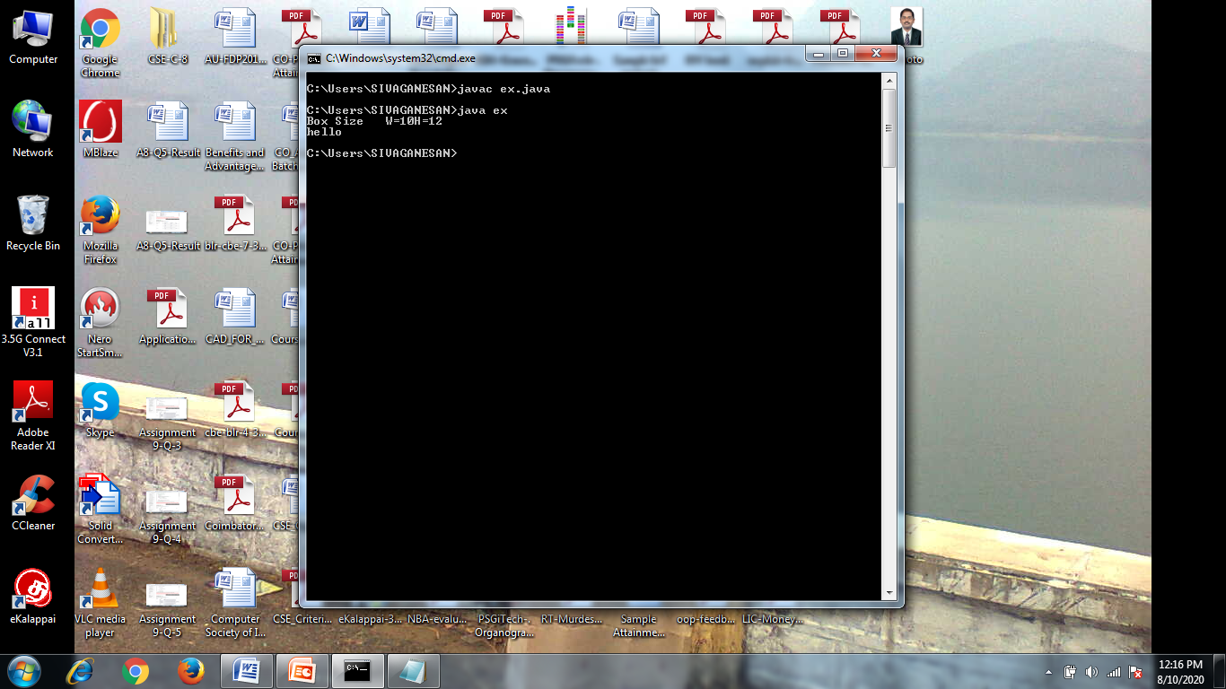

Slide 18
Thank you

